Slide 1
Java Enterprise Edition

Slide 2
Giorno 1
Introduzione alla piattaforma Java EE 6, le tecnologie fondamentali: Web Applications, Enterprise
Applications, Web Services.
Comunicazione sincrona e asincrona, topologie di rete e clustering.
Disposizione su livelli (client, presentazione, servizio, integrazione, persistenza)
Esercitazione: creare un applicativo Java EE end-to-end.

Slide 3
Releases
J2EE 1.2 (December 12, 1999)
J2EE 1.3 (September 24, 2001)
J2EE 1.4 (November 11, 2003)
Java EE 5 (May 11, 2006)
Java EE 6 (December 10, 2009)
Java EE 7 (May 28, 2013,^{[3]} but April 5, 2013 according to spec document. June 12, 2013 was the planned kickoff date^{[4]})
Java EE 8 (expected around Q3 2016^{[5]})

Slide 4

Technologies (1)
Java EE Platform
Java Platform, Enterprise Edition 7 (Java EE 7)
Web Application Technologies
Java API for WebSocket
Java API for JSON Processing
Java Servlet 3.1
JavaServer Faces 2.2
Expression Language 3.0
JavaServer Pages 2.3
Standard Tag Library for JavaServer Pages (JSTL) 1.2

Slide 5
Technologies (2)
Enterprise Application Technologies
Batch Applications for the Java Platform
Concurrency Utilities for Java EE 1.0
Contexts and Dependency Injection for Java 1.1
Dependency Injection for Java 1.0
Bean Validation 1.1
Enterprise JavaBeans 3.2
Interceptors 1.2
Java EE Connector Architecture 1.7
Java Persistence 2.1
Common Annotations for the Java Platform 1.2
Java Message Service API 2.0
Java Transaction API (JTA) 1.2
JavaMail 1.5 JSR 919 Download spec

Slide 6
Technologies (3)
Web Services Technologies
Java API for RESTful Web Services (JAX-RS) 2.0
Implementing Enterprise Web Services 1.3
Java API for XML-Based Web Services (JAX-WS) 2.2
Web Services Metadata for the Java Platform
Java API for XML-Based RPC (JAX-RPC) 1.1 (Optional)
Java APIs for XML Messaging 1.3
Java API for XML Registries (JAXR) 1.0
Management and Security Technologies
Java Authentication Service Provider Interface for Containers 1.1
Java Authorization Contract for Containers 1.5
Java EE Application Deployment 1.2 (Optional)
J2EE Management 1.1
Debugging Support for Other Languages 1.0
Java EE-related Specs in Java SE
Java Architecture for XML Binding (JAXB) 2.2
Java API for XML Processing (JAXP) 1.3
Java Database Connectivity 4.0
Java Management Extensions (JMX) 2.0
JavaBeans Activation Framework (JAF) 1.1
Streaming API for XML (StAX) 1.0

Slide 7
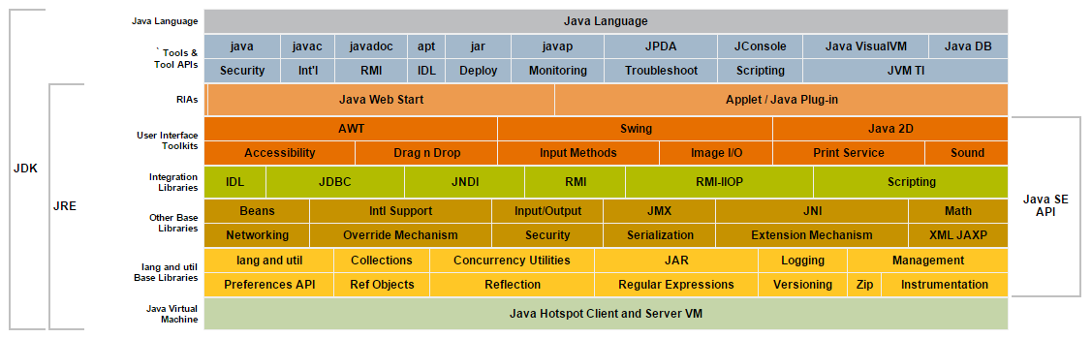
Java SE

Slide 8
JEE features
Application model
Multi tiered application
JEE containers
Security
Transaciotn
Lookup
Remoting
Web services
Assembly e deployment (EARs, WARs, JARs)

Slide 9
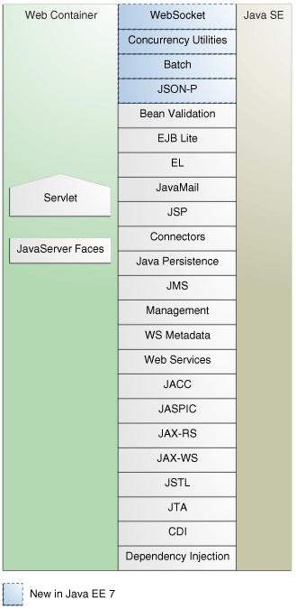
Web APIs

Slide 10
Web profile
Specification | Java EE 6^{[6]} | Java EE 7^{[3]}
Servlet | 3.0 | 3.1
JavaServer Pages (JSP) | 2.2 | 2.3
Unified Expression Language (EL) | 2.2 | 3.0
Debugging Support for Other Languages (JSR-45) | 1.0 | 1.0
JavaServer Pages Standard Tag Library (JSTL) | 1.2 | 1.2
JavaServer Faces (JSF) | 2.0 | 2.2
Java API for RESTful Web Services (JAX-RS) | 1.1 | 2.0
Java API for WebSocket (WebSocket) | n/a | 1.0
Java API for JSON Processing (JSON-P) | n/a | 1.0
Common Annotations for the Java Platform (JSR-250) | 1.1 | 1.2
Enterprise JavaBeans (EJB) | 3.1 Lite | 3.2 Lite
Java Transaction API (JTA) | 1.1 | 1.2
Java Persistence API (JPA) | 2.0 | 2.1
Bean Validation | 1.0 | 1.1
Managed Beans | 1.0 | 1.0
Interceptors | 1.1 | 1.2
Contexts and Dependency Injection for the Java EE Platform | 1.0 | 1.1
Dependency Injection for Java | 1.0 | 1.0

Slide 11
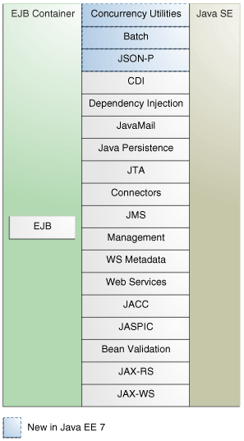
EJB APIs

Slide 12
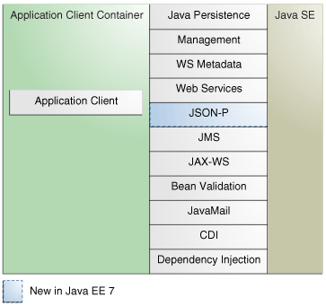
SE APIs

Slide 13
API
3.1 javax.servlet.*
3.2 javax.websocket.*
3.3 javax.faces.*
3.4 javax.faces.component.*
3.5 javax.el.*
3.6 javax.enterprise.inject.*
3.7 javax.enterprise.context.*
3.8 javax.ejb.*
3.9 javax.validation.*
3.10 javax.persistence.*
3.11 javax.transaction.*
3.12 javax.security.auth.message.*
3.13 javax.enterprise.concurrent.*
3.14 javax.jms.*
3.15 javax.batch.api.*
3.16 javax.resource.*

Slide 14
JEE sample project
Directory structure
Build, packaging and deployment tool (ant, maven)
IDE (eclipse)
Glassfish Tools
M2E
Configurazione repositories
Esecuzione archetipi
DB (mysql)

Slide 15
Comunicazione sincrona e asincrona, topologie di rete e clustering.
Call & wait
Call & callback
Queuing (JMS)
Remoting
RMI (CORBA, etc.)
WS
EJB3
Spring
Server => Cluster => PaaS > Cloud

